Slide 1
Object Oriented Programming

Slide 2
Overview
Classes and objects in C#
Overview of OOPs
Constructors
Using this keyword
Types of methods
Access modifiers
Static blocks
Constructor overloading
Method overloading

Slide 3











Observe the following image
Explain what have you seen?
People
Things
Notes:
Show the following image to the students for a flick of a second
Ask the students what they have observed in the image
Again show the image for a little longer and ask the students what they have observed
Again show the image for a little more longer and ask the students what they have observed

Slide 4

What is an Object?
Object is defined by its state and behavior
State represents physical looking of an object
Behavior represents functionality of the object
Example: Marker
State – solid, colors, length, price etc
Behavior – to write something
Notes:
How to recognize state and Behavior of the object easily?
All nouns of an object is state of an object.
All verbs of an object is behavior of an object.

Slide 5
What Is An Object ?
Object
State
Nouns
Behavior
Verbs
Marker
length, width color
Variables
to Write()
Methods

Slide 6

What Is An Object ?
Identify Difference

Slide 7



Identify Objects in a Dice Game
Dice 2
Dice 1
Player 1
Player 2

Slide 8

What is a class?
A class describes an object
Class is a blueprint of an object
A Class is a Collection of Datamembers and
member functions
Notes:
A class describes the common features of an Object.
It is a conceptual entity. It provides us a template i.e describing the object.

Slide 9
Classes and Objects:
List out the properties & behaviors of Player class
Hint :
What is interesting about player?
What does a player do?

Slide 10
Classes and Objects
Properties & Behaviors of Classes in Dice Game
Dice
P Player
Properties
faceValue
Properties
name
value
Behaviors
roll
Behaviors
throw

Slide 11
Classes and Objects
class Dice{
int faceValue;
void roll(){
//random no. between 1 and 6
//some logic
}// end of roll
}// end of class
Di Dice
Properties
faceValue
Behaviors
roll

Slide 12
Classes and Objects
class Player{
String name;
int value;
void throwDice(){
//some logic
}
}// end of class
Player
Properties
name
value
Behaviors
throwDice

Slide 13
Classes and Objects
Each object represents an instance of some class
Objects communicate by passing messages (by calling methods)
A message is always given to some object
The response to a message depends upon the class of the Object

Slide 14
Classes and Objects
All messages have three parts
1. Message Receiver
playerOne.throwDice(diceOne,diceTwo)
2. Message
3. List of arguments

Slide 15
Classes and Objects
Steps in Object Communication
Define Classes
Step 1
Create Objects
Step 2
Pass Messages
Step 3

Slide 16
Defining a class
class classname {
type instance-variable1;
type instance-variable2;
// ...
type instance-variableN;
type methodname1(parameter-list) {
// body of method
}
type methodname2(parameter-list) {
// body of method
}
// ...
type methodnameN(parameter-list) {
// body of method
}
}
Example :
class Dice{
int faceValue;
void roll(){
//some logic
}// end of roll
}// end of class

Slide 17
Creating Objects
ClassName refVariable;
refVariable= new Classname();
or
ClassName refVariable = new Classname();
Example :
Dice diceOne ;
diceOne = new Dice();
or
Dice diceTwo = new Dice();

Slide 18
Example of Product Class
class Product
{
public string Name;
public int ProductId;
public double Price;
public void Display()
{
System.Console.WriteLine(“Name:”+Name); System.Console.WriteLine(“ID:”+ProductId); System.Console.WriteLine(“Price:”+Price);
}
}
Responsibility of this class is the integrity of details of product
Data Members
Method or Member Function
Accessing Members
with in the method of the same class

Slide 19
Class Members
Variables , Methods and Constructors defined inside a class are called members of the class
Types of Members
Data members/Fields
Member Functions
Methods
Constructors
Destructors
Operators
Properties
Indexer

Slide 20
Data Member Declaration
A Data member is a variable declared inside a class
Data members are also called as class variables

Slide 21
Data Member Declaration
<modifier> <data type> <name>
Modifiers
Data Type
Name
private
String
Variable Name
Ex:
private int Product_Id ;
public string Product_Nam; public double salary ;

Slide 22
Creating Object
To create a object new keyword is used
Members of a class are accessed using . Operator
class Test
{
static void Main()
{
Product p1=new Product()
}
}
p1.ProductId=10
p1.Name=“Keyboard”
p1.price=300
p1.Display()

Slide 23
Method Declaration
A Method is a sub-program consist of one or more executable statements
Methods divide an application into logical units
To use Method, you required:
Define Methods
Call Methods
Notes:
Methods makes the application easy to read and understand

Slide 24
Method Declaration contd…
The following syntax can be used to define a method
<Access Specifier> <Return Type> <Method Name>(Parameter List)
{
Method body
}
Notes:
A method is a code block containing a series of statements. In C#, every executed instruction is done so in the context of a method.
Methods are declared within a class or structure by specifying the access level, the return value, the name of the method, and any method parameters.
Method parameters are surrounded by parentheses, and separated by commas. Empty parentheses indicate that the method requires no parameters.

Slide 25
Method Declaration contd…
The building blocks of a method are
Access Specifier
Return Type
Method Name
Parameter List
Method body
Notes:
Access Specifier – determines the extent to which a method can be access from another class
Return Type – A Method can return a value of any type. If the method doesn't return any value use void as the return type
Method Name – Unique-identifier name
Parameter List – Used to pass and receive data from a method
Method body – Contains set of instructions that perform a specific task

Slide 26
Method Calling
Method can be called by using the name of the
method
The method name is followed by parentheses
MethodName();
MethodName(value1,value2);
Dice diceOne = new Dice();
diceOne.roll();
int value = diceOne.faceValue();

Slide 27
Calling Methods contd…
Class Calculator
{
public int Addnumber(int n1,int n2)
{
int result;
result=n1+n2;
return result;
}
static void Main()
{
Calculator calc=new Calculator();
int value=calc. Addnumber(3,5);
Console.WriteLine(“The result is {0}”,value);
Console. Read();
}
}

Slide 28
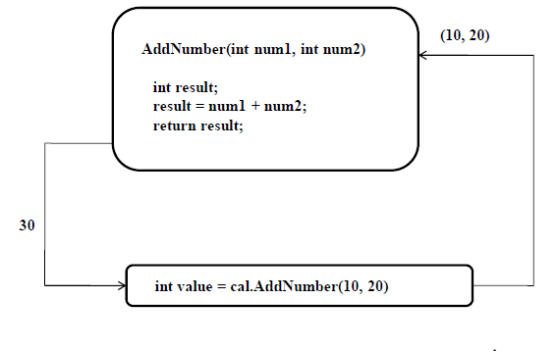
Calling Methods contd…

Slide 29
Tell more about what you have seen?
O Observe the image again
Triangles, Circles, Rectangles, Squares and Pentagons
Notes:
Observe the pictures

Slide 30
O Observe the image again
Tell every thing you have seen?
Different Sizes, Different Colors
2 Triangles, 2 Circles,
2 Rectangles, 3 Squares and
2 Pentagons
Notes:
What did you observe ?

Slide 31
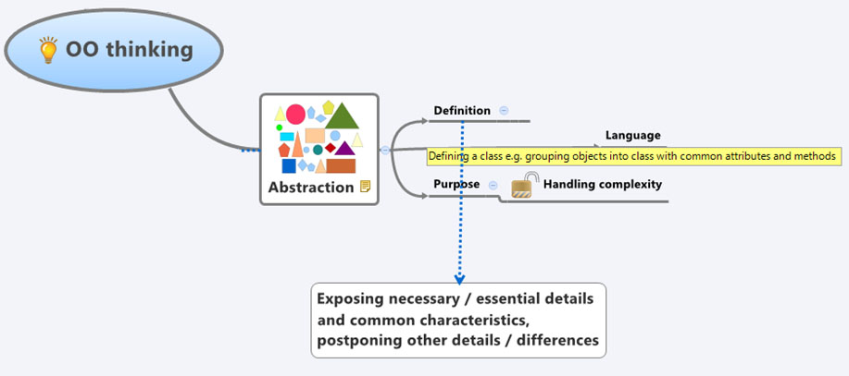
Abstraction
Notes:
Abstraction allows relevant information visible and encapsulation enables a programmer to implement the desired level of abstraction.

Slide 32

Examples of Abstraction

Slide 33



Example

Slide 34


Encapsulation
Tablet
Capsule
Which one you prefer?
Prefer capsule to avoid bitter taste of medicine.
Notes:
Encapsulation is defined 'as the process of enclosing one or more items within a physical or logical package'.
Encapsulation, in object oriented programming methodology prevents access to implementation details.
Abstraction and encapsulation are related features in object oriented programming.
Abstraction allows relevant information visible and encapsulation enables a programmer to implement the desired level of abstraction

Slide 35
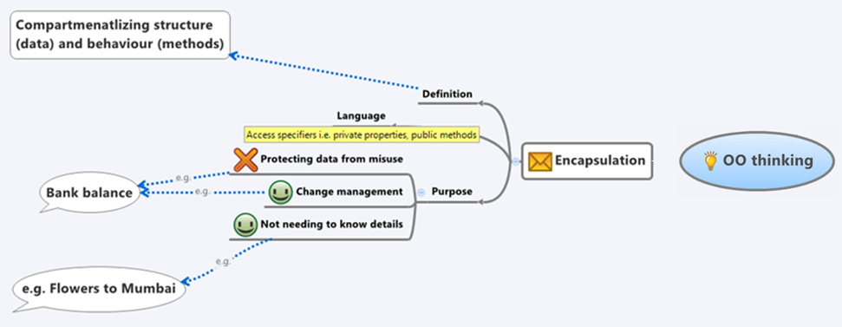
Encapsulation

Slide 36
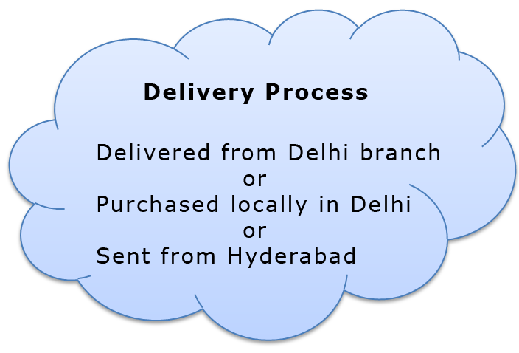



Encapsulation
Details Of Delivery Not Required
Ordering a Bouquet online from Hyderabad
Bouquet delivered in Delhi

Slide 37



Encapsulation
Details not required

Slide 38
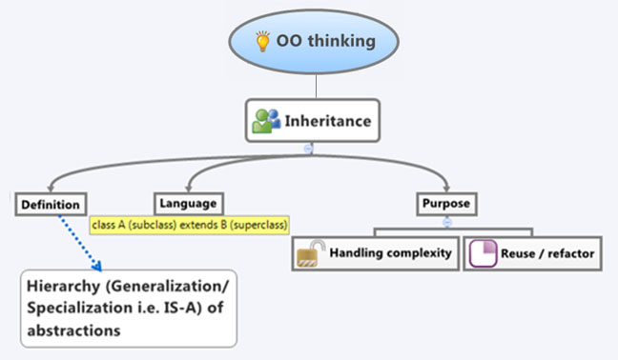
Inheritance
Notes:
One of the most important concepts in object-oriented programming is inheritance.
Inheritance allows to define a class in terms of another class, which makes it easier to create and maintain an application.
This also provides an opportunity to reuse the code functionality and fast implementation
When creating a class, instead of writing new data members and member functions, the programmer can designate that the new class should inherit the members of an existing class.
This existing class is called the base class, and the new class is referred to as the derived class.
The idea of inheritance implements the IS-A relationship. For example, mammal IS A animal, dog IS-A mammal hence dog IS-A animal as well.

Slide 39
Is-A
SHAPES

Slide 40




Inheritance
D
CTOR
IS-A
IS-A
IS-A
Pediatrician
Gynecologist
Geriatrician

Slide 41



Inheritance
CAR
IS-A
IS-A
IS-A

Slide 42


Inheritance
Same Rule Book
Same Exam Process
Student
IS-A
IS-A
IS-A
IS-A
Convener Quota | Management Quota | Spot Admission | Lateral Entry
Student Type

Slide 43

Polymorphism

Slide 44
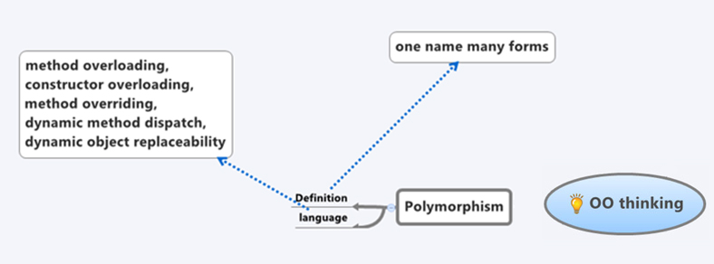
Polymorphism
Notes:
The word polymorphism means having many forms. In object oriented programming paradigm, polymorphism is often expressed as 'one interface, multiple functions'.
Polymorphism can be static or dynamic. In static polymorphism the response to a function is determined at the compile time. In dynamic polymorphism it is decided at run time.
Static Polymorphism
The mechanism of linking a function with an object during compile time is called early binding. It is also called static binding. C# provides two techniques to implement static polymorphism.
They are:
Function overloading
Operator overloading

Slide 45
Constructors
Constructors are similar to functions
Have same name as class name
Automatically called when ever an object of the class
is created
Constructors initialize the object
Example :
class Car{
public Car() { // this is constructor
. . .
}
}
Notes:
A special method of the class that will be automatically invoked when an instance of the class is created is called as constructor. Constructors can be classified into 5 types
Default Constructor
Parameterized Constructor
Copy Constructor
Static Constructor
Private Constructor

Slide 46
Constructors contd…
Program | JVM Memory
class Car{ String name; public Car(){ name=“My Car”; } } class MainClass{ public static void Main(){ Car c ; c = new Car(); } } | Stack memory | Heap memory
Constructor of the Car Class
name
My Car
Reference variable
(Declaration)
c
Calls the constructor
Allocates memory for the object
(for Instantiation)

Slide 47
Constructors contd…
Program | JVM Memory
class Car{ String name; public Car(){ name=“My First Car”; } } class MainClass{ public static void main(String args[]){ Car c1,c2; c1 = new Car(); c2 = new Car(); } } | Stack memory | Heap memory
c1
name
My First
Car
c2
name
My First
Car
Notes:
A constructor without any parameters is called as default constructor.

Slide 48
Constructors contd…
Program | JVM Memory
class Car{ String name; public Car(String carName){ name= carName; } } class MainClass{ public static void main(String args[]){ Car c1,c2; c1 = new Car(“My First Car”); c2 = new Car(“My Second Car”); } } | Stack memory | Heap memory
c1
name
My First
Car
c2
name
My Second
Car
Notes:
A constructor with at least one parameter is called as parameterized constructor.
Advantage of parameterized constructor is you can initialize each instance of the class to different values.

Slide 49
this keyword:
this is a keyword which contains the current object reference
Program
class Car{ String name; public Car(){ name=“My First Car”; } public Car(String name ){ this.name=name; } } class MainClass{ public static void main(String args[]){ Car c 1,c2; c1 = new Car(); c 2 = new Car(“My Second Car”); }}
Refers to the current object
Notes:
The this keyword refers to the current instance of the class.
It can be used to access members from within constructors, instance methods.
It can be used to the current object pass an object as a parameter to a method.
call(this);
this is also used for constructor chaining or call one constructor into another.
to declare indexers.

Slide 50
this keyword contd…
Explicit constructor invocation
public class MyClass {
private int x, y, a, b;
public MyClass() : this(0, 0, 0, 0)
{
}
public MyClass(int a, int b) {
this(0, 0, a, b);
}
public MyClass(int x, int y, int a, int b) {
this.x = x;
this.y = y;
this.a = a;
this.b = b;
}
...
}
Notes:
Call another constructor in the same class.

Slide 51
Constructor Overloading
Having multiple constructors with different parameters in a class
Example:
class Loan{
String loanType;
public loan(){
}
public loan(String type){
this.loanType= type;
}
}
Notes:
C# supports overloading of constructors, that means, we can have constructors with different sets of parameters.

Slide 52
Default Constructor
C# compiler adds a default constructor to a class if it
doesn’t contain a constructor

Slide 53
Types of methods
Methods are of 3 types:
Static method
Instance method
Abstract method

Slide 54
Static Method
A static method can be called and executed without creating an object
Static method can be invoked directly using class name
All C# program needs a Main method which is static
Syntax:
<access-modifiers> static <return type> <method name>(<parameters>); Eg: public static void main()
Notes:
A static method does not operate on a specific instance, and it is a compile-time error to refer to this in a static method.

Slide 55
Instance Method
These methods act upon the instance variables of a class
Instance methods are invoked with an object <<object reference>>.<<method-name>>;
Notes:
An instance method operates on a given instance of a class, and that instance can be accessed as this

Slide 56
Abstract method
Methods which have no definition are called abstract methods
Must be preceded by abstract access modifier
Syntax:
<<access-modifier>> abstract <<return-type>> method- name(parameters);
Example: public abstract void run();
Note: All access modifiers are not applicable with abstract access modifier.
Notes:
An abstract method declaration introduces a new virtual method but does not provide an implementation of that method. Instead, non-abstract derived classes are required to provide their own implementation by overriding that method. Because an abstract method provides no actual implementation, themethod-body of an abstract method simply consists of a semicolon.

Slide 57
Access Modifiers
public
private
protected
static
const
abstract

Slide 58
public
A class, method, constructor, interface ,variable declared public can be accessed from any where
public static void main() { // ... }
Notes:
Therefore fields, methods, blocks declared inside a public class can be accessed from any class.
However if the public class we are trying to access is in a different package, then the public class still need to be imported.
Because of class inheritance, all public methods and variables of a class are inherited by its subclasses.

Slide 59
private
Private methods, variables and constructors can be accessed only within class
Class and interfaces cannot be private
Private variables can be accessed outside the class using properties of the class
Data hiding can be achieved using private modifier
Notes:
The type or member can be accessed only by code in the same class or structure.

Slide 60
static
static variables
static methods
static blocks
Notes:
In C#, data members, member functions, properties and events can be declared either as static or non-static. Only one copy of static fields and events exists, and static methods and properties can only access static fields and static events.
Static members are often used to represent data or calculations that do not change in response to object state.
Static can be used in following ways:
Static data members
Static constructor
Static Properties
Static methods

Slide 61
Static variables
Variable which belongs to the class and not to object(instance)
Also called as class variables
Static variables are initialized only once , at the start of the execution
A single copy shared by all instances of the class
A static variable can be accessed directly by the class name and doesn’t need any object
Syntax : <class-name>.<variable-name>
Notes:
The Static keyword indicates that one or more declared variables are static. Static variables remain in existence and retain their latest values after termination of the procedure in which they are declared.

Slide 62
constant
Constant variables cannot be reassigned
Constant variables declared using const keyword
Const variables must be initialized during declaration
Notes:
The const keyword is used to modify a declaration of a field or local variable. It specifies that the value of the field or the local variable is constant, which means it cannot be modified.
const int x = 0;
public const double gravitationalConstant = 6.673e-11;
private const string productName = "Visual C#";

Slide 63
Method overloading
Methods with same name but with different parameters present in a class are called method overloading
Different :
Data types
number of parameters
Sequence of Parameters
Notes:
overloading is what happens when you have two methods with the same name but different signatures. At compile time, the compiler works out which one it's going to call, based on the compile time types of the arguments and the target of the method call.

Slide 64
Method Overloading
Example:
public class ArithmeticOperation
{
public void add( int a,int b){//}
public void add(float a,float b){//}
public void add( int a,float b){//}
public void add(float a,int b){//}
public void add( int a,int b,int c){//}
}

Slide 65
protected
Variables, methods and constructors declared as protected can be accessed only in derived classes
The protected access modifier cannot be applied to class and interfaces
Methods and fields in an interface cannot be declared protected
Notes:
The protected keyword is a member access modifier. A protected member is accessible from within the class in which it is declared, and from within any class derived from the class that declared this member.
A protected member of a base class is accessible in a derived class only if the access takes place through the derived class type

Slide 66


